Slide 1
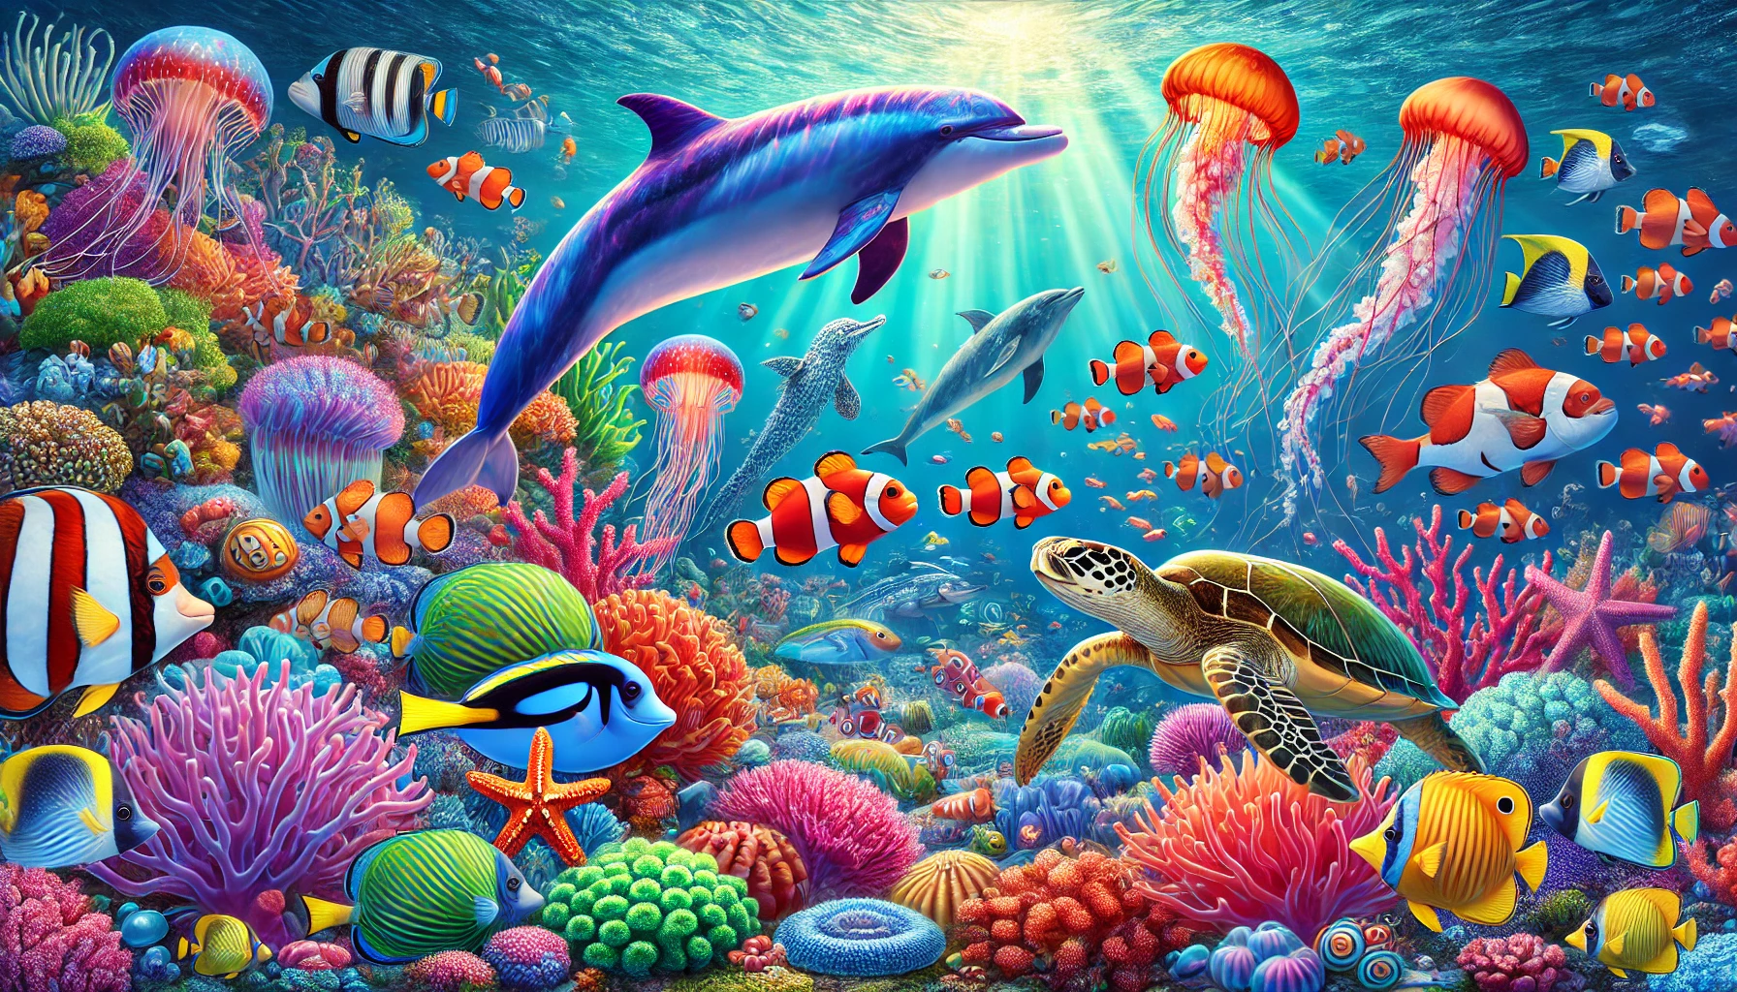
Little Diver Artists
Coloring Book

Slide 2


Trace & Color
Sea Animals
Fish

Slide 3
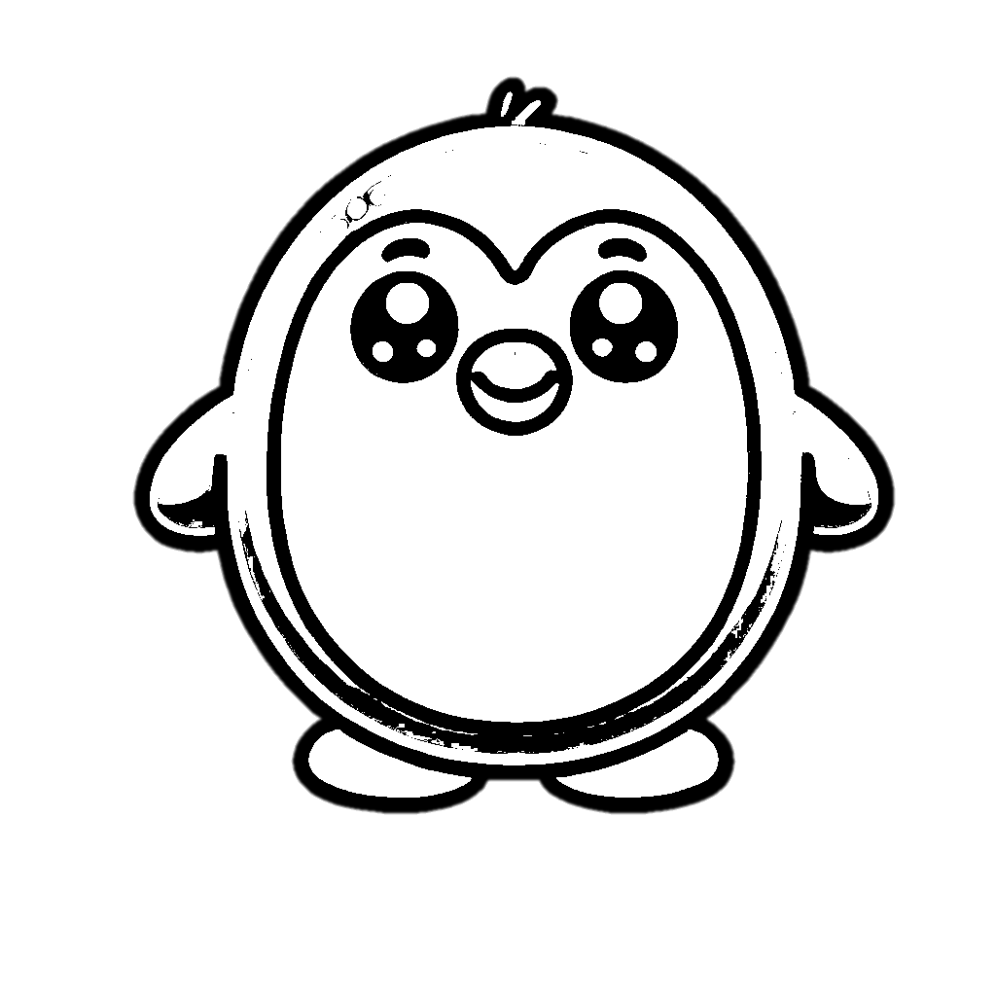

Trace & Color
Sea Animals
Penguin

Slide 4


Trace & Color
Sea Animals
Pelican

Slide 5


Trace & Color
Sea Animals
Seagull

Slide 6


Trace & Color
Sea Animals
Oyster

Slide 7


Trace & Color
Sea Animals
Scallop

Slide 8


Trace & Color
Sea Animals
Clam

Slide 9


Trace & Color
Sea Animals
Urchin

Slide 10


Trace & Color
Sea Animals
Coral

